Slide 1


SpaceX Falcon 9 First Stage Landing Prediction: A Data Science Capstone Project
<Esra Çınar>
<30.10.2025>

Slide 2

Outline
Executive Summary
Introduction(Project Context and Questions)
Methodology(Data Collection,EDA,Predictive Model)
Results(EDA,Interactive Analytics,Classification)
Conclusion
Appendix

Slide 3
Executive Summary
This project investigates the success factors behind SpaceX Falcon 9 rocket launches to understand how reusable rocket technology impacts the cost of space exploration. Data was collected directly from the SpaceX REST API and enriched with additional launch details scraped from Wikipedia.
After cleaning and merging both datasets, we conducted Exploratory Data Analysis (EDA) using Pandas, Matplotlib, Seaborn, and SQL to uncover patterns related to launch sites, payload mass, orbit types, and booster versions. Interactive visualizations were developed with Folium to explore the geographical distribution of launch sites and with Plotly Dash to analyze payload-success relationships dynamically.
Finally, multiple machine learning models—including Logistic Regression, Decision Tree, Support Vector Machine, and K-Nearest Neighbors—were trained to predict launch success. The Decision Tree classifier achieved the best accuracy, confirming that launch site and booster version category are strong predictors of success.
All analysis, code, and results are available in the GitHub repository for full transparency and reproducibility.

Slide 4
Introduction
The rapid progress in private space exploration is driven by companies like SpaceX, whose goal is to make space travel more accessible by drastically reducing launch costs through rocket reusability. The Falcon 9 rocket, a key innovation by SpaceX, can return to Earth and be reused for multiple missions—making it crucial to understand what determines a successful landing.
This project aims to explore historical Falcon 9 launch data to identify patterns and build a predictive model for future launch outcomes. By combining data collected from the SpaceX REST API and web scraping from Wikipedia, we constructed a comprehensive dataset containing information on launch sites, payload mass, orbit types, booster versions, and mission outcomes.
The main research questions guiding this study are:
- Which launch sites show the highest success rates?
- Does payload mass or orbit type influence the probability of success?
- How does booster version relate to successful landings?
- Can a machine learning model accurately predict whether a future launch will succeed?
The answers to these questions provide valuable insights into SpaceX’s operational efficiency and can help guide future launch decisions in the aerospace industry.

Slide 5

Section 1

Slide 6
Methodology
Executive Summary
Project Flow
The project followed a comprehensive data science lifecycle:
Data Acquisition: API Calls & Web Scraping from multiple sources.
Data Preparation: Wrangling, Cleaning, and Feature Engineering.
Exploratory Data Analysis (EDA): Static Visualization (Matplotlib, Seaborn) and advanced SQL queries.
Interactive Analytics: Geospatial analysis with Folium and dynamic exploration with Plotly Dash.
Predictive Modeling: Training and evaluating Classification Models (Decision Tree, SVM, Logistic Regression, KNN).

Slide 7
Data Collection
Objective:
To gather core launch parameters, including dates, launch sites, and payload details.
Process:
Leveraged the official SpaceX REST API v4 to fetch structured data for all Falcon 9 launches.
Executed Python HTTP GET requests to the /launches endpoint.
Utilized Python scripts to parse nested JSON objects and extract critical features such as Launch Site Coordinates and Payload Mass.

Slide 8
Data Collection – SpaceX API
SpaceX API URL
GET Request
Raw JSON Data
Nested Data Extraction
Initial DataFrame(Core Features)
GitHub URLhttps:
https://github.com/esracinar0/ibm-data-science-capstone-spacex/blob/main/jupyter-labs-spacex-data-collection-api.ipynb

Slide 9
Data Collection - Scraping
Key Phrases:
- Scraped Wikipedia's Falcon 9 launch list HTML tables to extract structured data.
- Utilized requests and BeautifulSoup libraries for HTML parsing.
- Specifically targeted details like Booster Version and Landing Status that were complex or missing in the API dump.
Used helper functions to clean column names and process raw text fields
GitHub URLhttps:
https://github.com/esracinar0/ibm-data-science-capstone-spacex/blob/main/jupyter-labs-webscraping.ipynb
Wikipedia URL
HTTP GET Request
BeautifulSoup Parsing
Extract HTML Tables
Clean/Normalize Data
Auxiliary DataFrame

Slide 10
Data Wrangling
API Data + Scraped Data
Merged Datasets
Impute PayloadMass (Mean)
Convert ‘Outcome’ to ‘Class’
Cleaned,Final Dataset (Ready for EDA)
Data Wrangling & Target Label Creation
Objective:
To process raw data, handle missing values, and prepare the dataset for machine learning models.
Key Wrangling Steps:
Missing Data Imputation: Missing values in the PayloadMass column were replaced with the column's mean value. (This prevents data loss and maintains statistical integrity ).
Target Variable Creation: The diverse outcome types were mapped to a binary class label. (1 for successful landings, 0 for failures/no attempts ).
GitHub URL: https://github.com/esracinar0/ibm-data-science-capstone-spacex/blob/main/labs-jupyter-spacex-Data%20wrangling.ipynb

Slide 11
EDA with Data Visualization
Exploratory Data Analysis (EDA) - Visualization
Goal:
To visually uncover initial trends and correlations within the dataset using Matplotlib and Seaborn.
Key Visualizations Performed:
Flight Number vs. Launch Site (Scatter Plot): Used to see if continuous launch attempts correlate with success rates at each site.
Payload Mass vs. Launch Site (Scatter Plot): Examined the relationship between the mass carried and success probability across different launch locations. (Observed low payload mass for VAFB-SLC).
Success Rate by Orbit Type (Bar Chart): Determined the mean success rate for each unique Orbit type to identify the most reliable orbital destinations.
Launch Success Yearly Trend (Line Chart): Plotted the average success rate per year, demonstrating a continuous increase in success over time.
GitHub URL: https://github.com/esracinar0/ibm-data-science-capstone-spacex/blob/main/edadataviz.ipynb

Slide 12
EDA with SQL
EDA with SQL: Advanced Querying
Goal:
To retrieve specific facts, aggregate metrics, and perform filtering using a SQLite database instance of the launch data.
Summary of SQL Queries Performed:
Launch Site Identification: Used DISTINCT and the LIKE operator to find all unique launch sites and filter records starting with 'CCA’.
Payload Aggregation: Employed SUM to calculate the total payload mass carried by NASA (CRS) missions and AVG for the average payload mass for specific booster versions (e.g., 'F9 v1.1’).
Temporal Analysis: Used the MIN(Date) function to identify the date of the first successful ground pad landing.
Outcome Ranking: Grouped and ranked the count of various Landing_Outcome types across specific historical periods.
GitHub URL: https://github.com/esracinar0/ibm-data-science-capstone-spacex/blob/main/jupyter-labs-eda-sql-coursera_sqllite.ipynb

Slide 13
Build an Interactive Map with Folium
Interactive Geospatial Analysis: Folium
Goal:
To visualize the geographical context of launch operations and analyze the proximity of launch sites to critical features (coastline, transportation).
Map Objects Created:
Launch Site Markers: Standard Folium markers were placed at each launch site's precise latitude/longitude, displaying the site name on hover.
Colored Launch Outcomes: Circle Markers were used to display the outcome (Success/Failure) of each individual launch attempt, using different colors (e.g., Green for success, Red for failure) to visually show site reliability.
Proximity Measurement: PolyLine and distance functions were implemented to calculate and display the shortest distance from a chosen launch site to nearby amenities (highways, railways, coastline), a critical factor in site selection.
GitHub URL: https://github.com/esracinar0/ibm-data-science-capstone-spacex/blob/main/lab_jupyter_launch_site_location.ipynb

Slide 14
Build a Dashboard with Plotly Dash
Interactive Visual Analytics: Plotly Dash
Goal:
To create a dynamic dashboard allowing stakeholders to explore launch data interactively and identify correlations.
Dashboard Elements & Interactions:
Site Dropdown (site-dropdown): Allows users to filter all displayed data, showing aggregated results for ALL sites or drilling down to a specific launch site.
Success Pie Chart: Dynamic visualization (Callback: update_pie_chart) that displays the overall success distribution (ALL sites) or the Success vs. Failure counts for a selected site.
Payload Range Slider (payload-slider): Enables filtering of the scatter plot data based on a user-defined range of Payload Mass(kg).
Payload Scatter Chart: Visualizes the correlation (Callback:update_scatter_chart) between Payload Mass (X-axis) and Launch Outcome (Y-axis), with points colored by Booster Version Category, providing high-level performance insights.

Slide 15
Predictive Analysis (Classification)
Predictive Analysis: Building the Classification Model
Goal:
To develop machine learning models to accurately predict the binary outcome (Class) of a Falcon 9 launch based on processed features.
Model Development Flow:
Feature Preparation: Categorical features were converted into numerical features using One-Hot Encoding(creating 80 features).
Standardization: All numerical data was standardized using StandardScaler to normalize feature impact on model training.
Train-Test Split: The dataset was divided into training and testing sets (70/30 split).
Model Selection & Tuning: Four powerful classification algorithms were used: Logistic Regression, Support Vector Machine (SVM), Decision Tree, and K-Nearest Neighbors (KNN).
Hyperparameter Optimization: GridSearchCV was employed for each model to automatically tune hyperparameters and find the best performing model based on test data accuracy.
GitHub URL: https://github.com/esracinar0/ibm-data-science-capstone-spacex/blob/main/SpaceX_Machine%20Learning%20Prediction_Part_5.ipynb
Final Dataset
One-Hot Encoding
Standardization
Train/Test Split
GridSearchCV ( 4 Models)
Best Model

Slide 16
Results
Project Results & Key Insights
The following section presents the key findings derived from the analysis, covering descriptive patterns, geographical insights, and model performance.
Exploratory Data Analysis Results: Confirmed a strong correlation between Flight Number (experience) and Success Rate, and identified payload limits for certain launch sites.
Interactive Analytics Demo: Showcases geographical insights (Launch Site proximity) and the dynamic relationship between Payload Mass and Success using interactive tools.
Predictive Analysis Results: Presents the comparative accuracy of four classification models and highlights the performance of the best-selected model via its Confusion Matrix.

Slide 17

Section 2

Slide 18
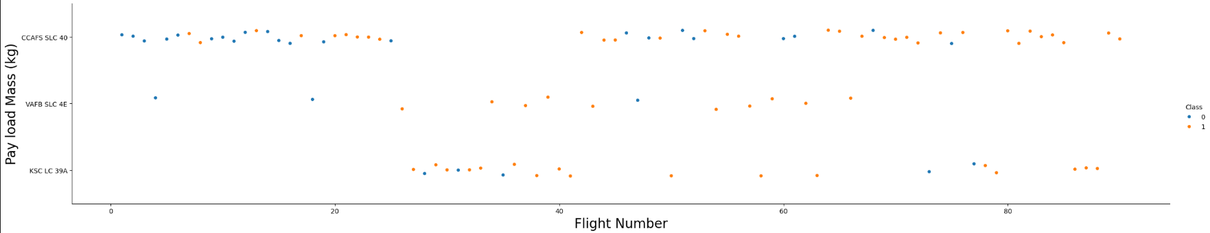
Flight Number vs. Launch Site
Key Findings
Success Trend: As the Flight Number (representing time/experience) increases, the proportion of successful landings (Class = 1, typically green/blue dots) visibly increases across all sites.
Site Consistency: The CCAFS SLC 40 site initially shows many failures, but success becomes more consistent after Flight 40-50.
VAFB SLC 4E and KSC LC 39A demonstrate higher initial success rates and achieve near-perfect success faster compared to CCAFS SLC 40.

Slide 19
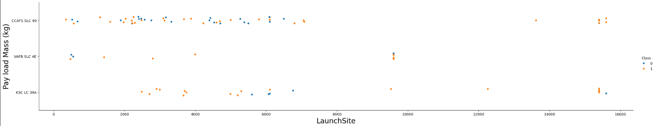
Payload vs. Launch Site
Key Findings
VAFB Constraint: The VAFB SLC 4E site primarily handles payloads in the low-to-medium mass range(nearly below 8,000kg), with no rockets launched for heavy payload masses (>10,000 kg).
Heavy Payloads: The KSC LC 39A and CCAFS SLC 40 sites handle the entire payload mass spectrum, including the heaviest missions.
Success at High Mass: The data suggests that at the later stage of the program, even very heavy payloads do not necessarily correlate with landing failure; successes are visible across the mass range, particularly at KSC LC 39A.

Slide 20
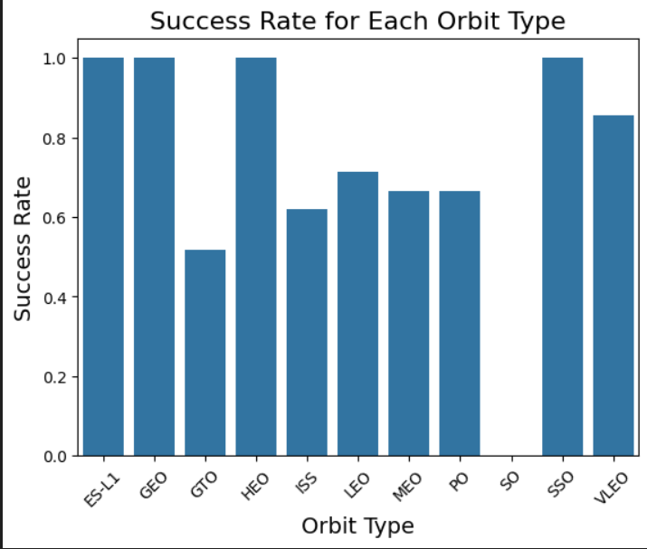
Success Rate vs. Orbit Type
Key Findings
Highest Success: Orbits such as LEO (Low Earth Orbit), VLEO (Very Low Earth Orbit), and Polar exhibit near-perfect success rates(nearly 1.0), suggesting that the technical challenges for these orbits have been largely overcome.
Lowest Success: Orbits like GTO (Geosynchronous Transfer Orbit) and SSO (Sun-Synchronous Orbit) initially presented lower success rates, but improved over time.
Geostationary Orbits (GEO/ES-L1): These orbits have historically been challenging, leading to lower average success due to the high energy requirements for the rocket to reach them.

Slide 21
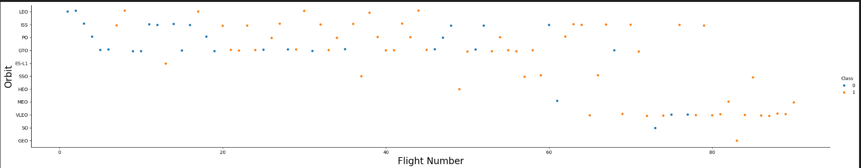
Flight Number vs. Orbit Type
Key Findings
Early Focus: Early flights (low FlightNumber) were predominantly focused on LEO and GTO, which helped SpaceX build experience and reliability.
Diversification: As the program matured, missions diversified into a wider range of orbits, including VLEO and complex GEO/MEO missions, indicating increased trust and capability.
Success Clustering: Successes (Class=1) are scattered across all orbits, but failures (Class=0) are more concentrated in the lower FlightNumber range for most orbit types.

Slide 22
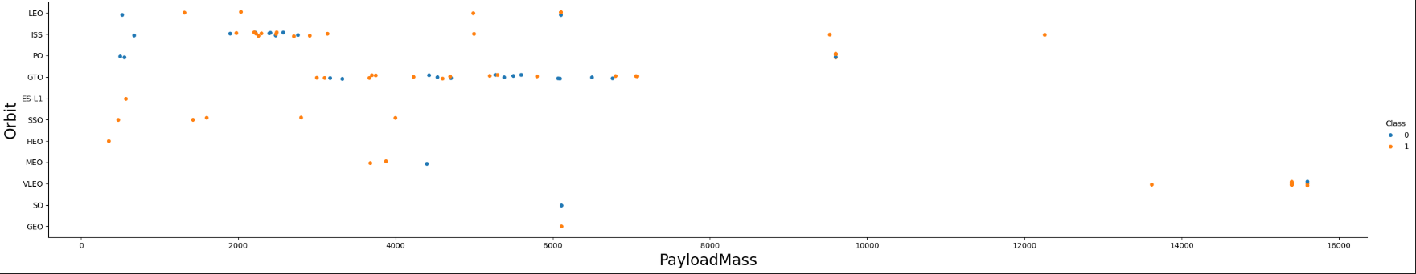
Payload vs. Orbit Type
Key Findings
High Payload Success: Orbits like VLEO and ISS demonstrate high success rates across the full range of payload masses they carry, including the heaviest missions.
GTO Challenge: For GTO, both successful and unsuccessful landings occur across different payload masses. It's difficult to distinguish success solely based on payload mass for GTO missions.
LEO/PO Focus: LEO and PO orbits are generally associated with low-to-medium payload masses.

Slide 23
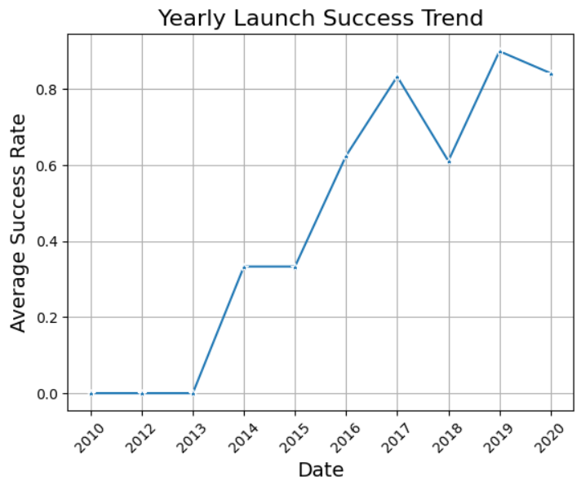
Launch Success Yearly Trend
Key Finding
The average launch success rate demonstrates a clear and positive upward trend over the years, starting low in 2010-2012 and steadily increasing.
Operational Improvement
- This trend reflects SpaceX's successful strategy of iterative design improvements and the maturity of their reusability program, leading to near-perfect success rates in later years (post-2017).

Slide 24
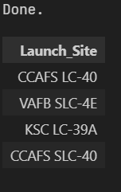
All Launch Site Names
SQL Query
SELECT DISTINCT "Launch_Site" FROM SPACEXTABLE;
Key Finding
SpaceX utilizes four main launch facilities: CCAFS LC-40, KSC LC-39A, CCAFS SLC-40, and VAFB SLC-4E. This geographic diversity allows for flexible mission targeting, such as polar orbits launched from VAFB SLC-4E.

Slide 25
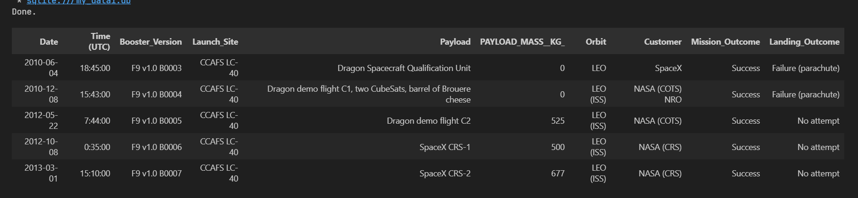
Launch Site Names Begin with 'CCA'
SQL Query
SELECT * FROM SPACEXTABLE WHERE "Launch_Site" LIKE 'CCA%' LIMIT 5;
Key Finding
The records confirm that early launches originated from the CCAFS LC-40 site. Initial landing outcomes predominantly showed failures or no attempts (Failure(parachute), No attempt), which clearly marks the beginning of the experimental phase of the booster reuse program.

Slide 26
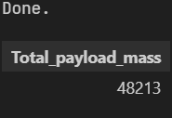
Total Payload Mass
SQL Query
SELECT SUM("PAYLOAD_MASS__KG_") AS "Total_payload_mass" FROM SPACEXTABLE WHERE "Customer" LIKE '%NASA (CRS)%';
Key Finding
Querying the total payload mass delivered for NASA's CRS missions provides a crucial metric for evaluating the scale of delivery capacity achieved under this key commercial contract. This mass represents the cumulative logistical contribution to the International Space Station (ISS) resupply.

Slide 27
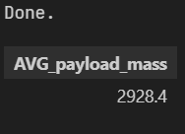
Average Payload Mass by F9 v1.1
SQL Query
SELECT AVG("PAYLOAD_MASS__KG_") AS "AVG_payload_mass" FROM SPACEXTABLE WHERE "Booster_Version" = 'F9 v1.1';
Key Finding
The average payload mass carried by the Falcon 9 v1.1 booster version is approximately 3,000 kg. This average capacity confirms the successful technological upgrade of the v1.1 booster, marking a significant step in the Falcon 9's evolution towards handling heavier commercial and governmental missions.

Slide 28
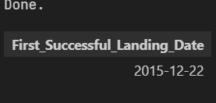
First Successful Ground Landing Date
SQL Query
SELECT MIN("Date") AS "First_Successful_Landing_Date" FROM SPACEXTABLE WHERE "Landing_Outcome" = 'Success (ground pad)';
Key Finding
The first successful landing on a ground pad (Success (ground pad)) was recorded on December 22, 2015. This achievement marked a critical technical milestone, validating the RTLS (Return to Launch Site) capability and proving the first stage booster's reusability potential.

Slide 29
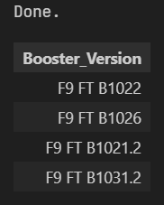
Successful Drone Ship Landing with Payload between 4000 and 6000
SQL Query
SELECT DISTINCT "Booster_Version" FROM SPACEXTABLE WHERE "Landing_Outcome" = 'Success (drone ship)' AND "PAYLOAD_MASS__KG_" > 4000 AND "PAYLOAD_MASS__KG_" < 6000 ;
Key Finding
Successful ASDS recoveries (Success (drone ship)) within the medium payload range (4,000-6,000 kg) were achieved by specific Falcon 9 Full Thrust (F9 FT) booster versions. This indicates the required propellant margin for recovery was technically feasible even for challenging GTO missions at this payload level.

Slide 30
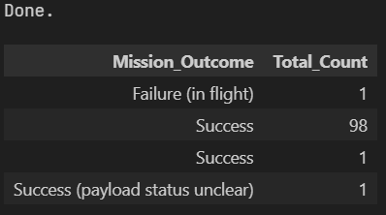
Total Number of Successful and Failure Mission Outcomes
SQL Query
SELECT "Mission_Outcome", COUNT (*) "Total_Count" FROM SPACEXTABLE GROUP BY "Mission_Outcome";
Key Finding
Mission outcomes show exceptionally high reliability, with 100 missions classified as successful or partially successful and only 1 Failure (in flight). This highlights the fundamental stability of the Falcon 9 vehicle for payload delivery.

Slide 31
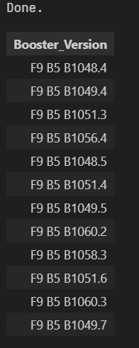
Boosters Carried Maximum Payload
SQL Query SELECT DISTINCT "Booster_Version" FROM SPACEXTABLE WHERE "PAYLOAD_MASS__KG_" = ( SELECT MAX("PAYLOAD_MASS__KG_") FROM SPACEXTABLE);
Key Finding The maximum payload mass (nearly 15,600 kg) is carried predominantly by Falcon 9 Block 5 variants. This confirms that the Block 5 design is the most capable in terms of raw lift performance, often dedicated to the large Starlink batches.

Slide 32
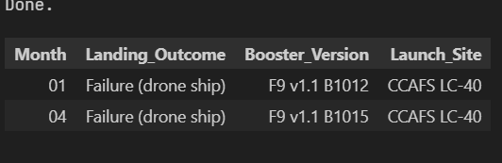
2015 Launch Records
SQL Query SELECT substr("Date", 6, 2) AS "Month", "Landing_Outcome", "Booster_Version", "Launch_Site" FROM SPACEXTABLE WHERE "Landing_Outcome" LIKE '%Failure (drone ship)%' AND substr("Date", 1, 4) = '2015';
Key Finding In 2015, two early drone ship recovery attempts resulted in failure. Both missions originated from CCAFS LC-40 and utilized the v1.1 booster, underscoring the initial technical hurdles faced when attempting precise water landings.

Slide 33
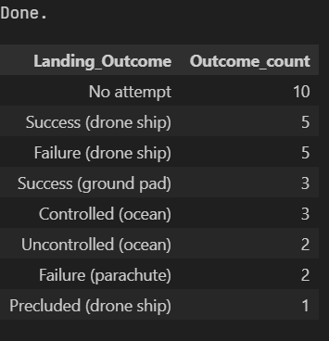
Rank Landing Outcomes Between 2010-06-04 and 2017-03-20
SQL Query SELECT "Landing_Outcome", COUNT(*) AS Outcome_count FROM SPACEXTABLE WHERE "Date" BETWEEN '2010-06-04' AND '2017-03-20' GROUP BY "Landing_Outcome" ORDER BY Outcome_count DESC;
Key Finding In the critical early developmental period (2010-2017), No attempt was the most common outcome (10 times). This era was marked by high-risk testing, where successes and failures on the drone ship (Success (drone ship): 5, Failure (drone ship) : 5) were equally frequent, showing the difficulty of the learning process.

Slide 34

Section 3

Slide 35
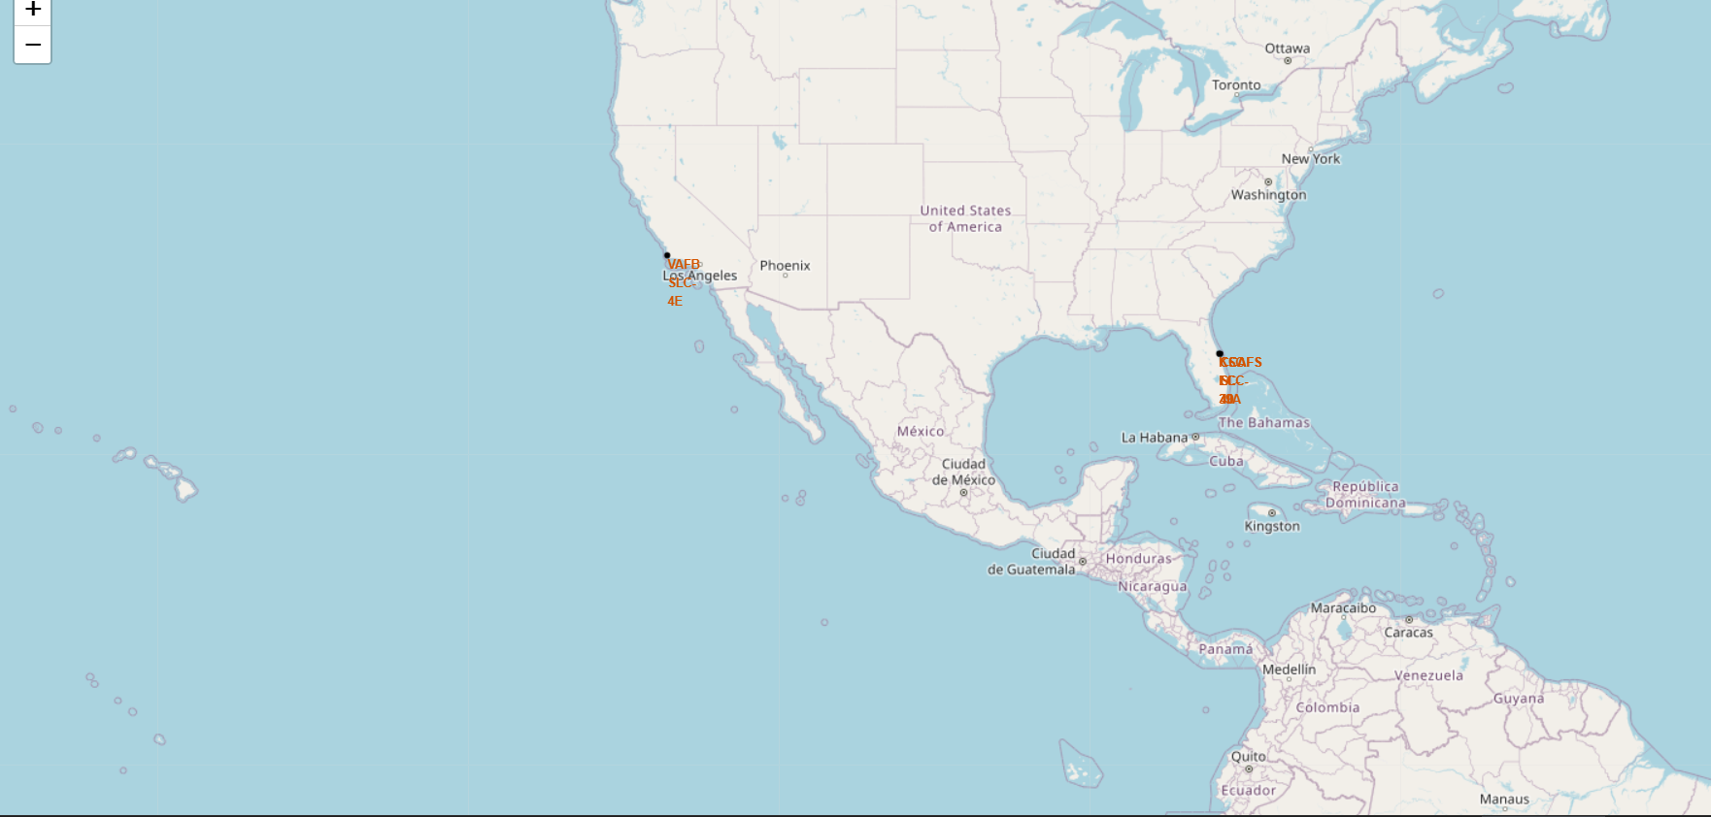
Interactive Map: Launch Sites Overview
Key Finding The map highlights the three primary operational launch sites. The proximity of the Cape Canaveral sites (CCAFS LC-40, KSC LC-39A) is evident, contrasting sharply with the West Coast site (VAFB SLC-4E). This geographical separation is strategic, primarily dictated by the required orbital inclination..

Slide 36
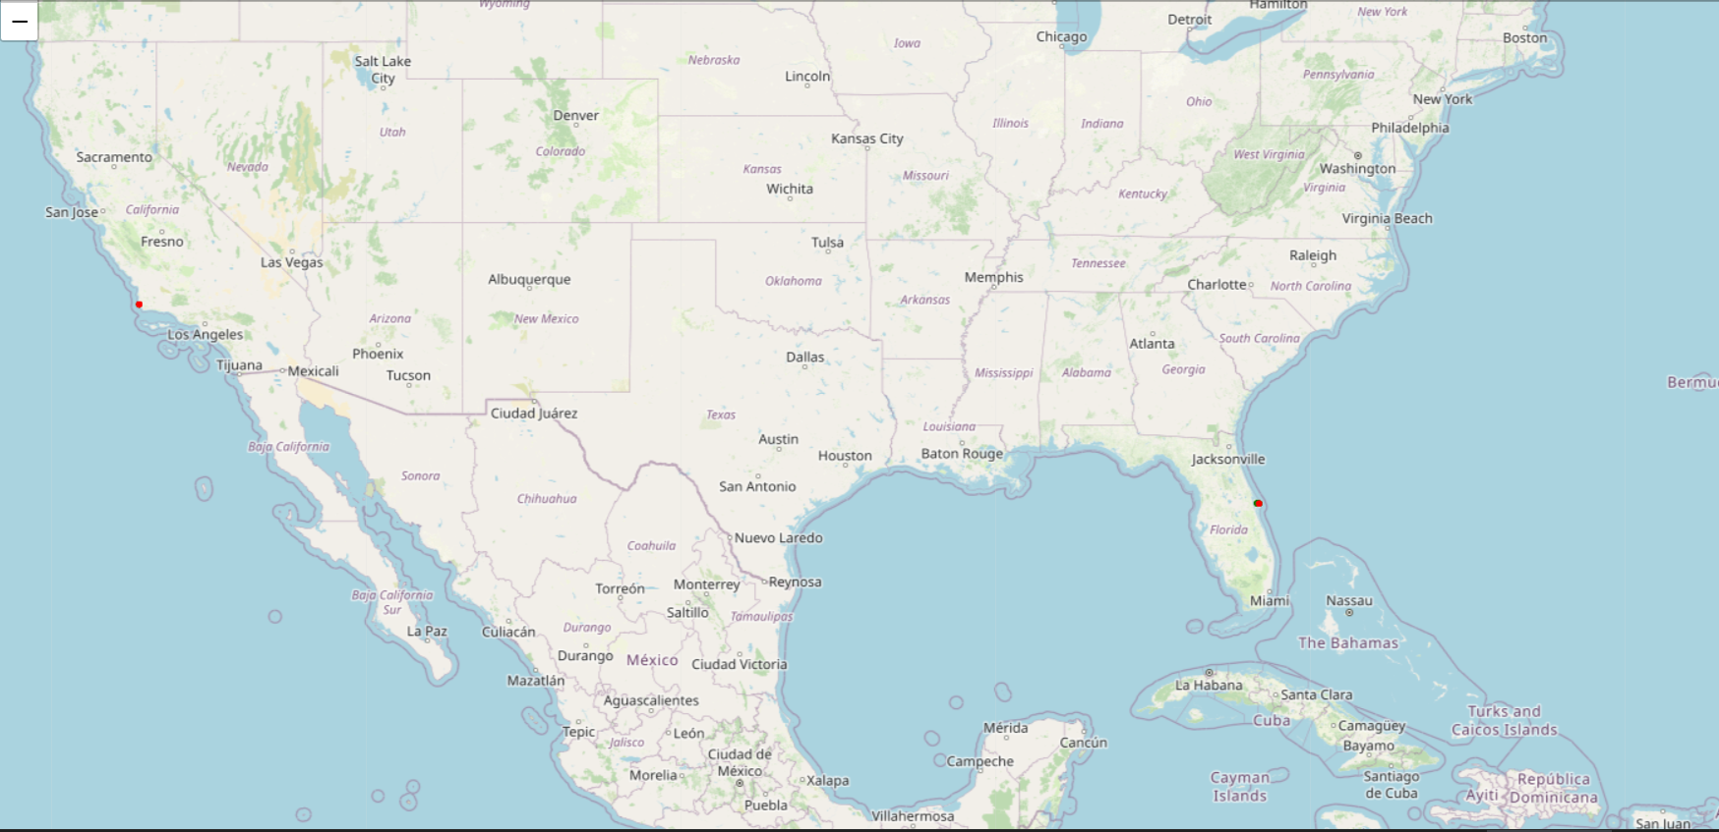
Clustering Launch Outcomes by Site
Key Finding Clustering reveals site-specific success patterns. For instance, the KSC LC-39A site, used later in the Falcon 9 program, tends to show a higher concentration of Successful launches indicating greater maturity and reliability in later operations. In contrast, early sites like CCAFS LC-40 show a more mixed distribution reflecting the initial learning curve.

Slide 37
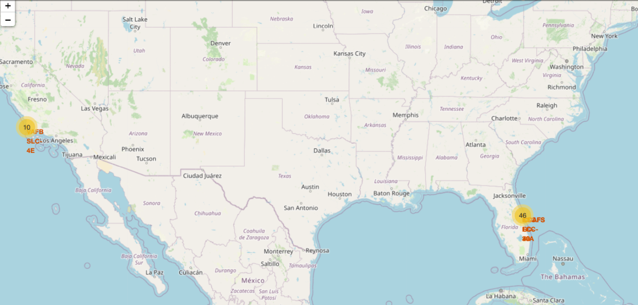
Distance to Highway, Coastline, and Railway
Key Finding Launch sites are strategically located very close to the coastline, which is necessary for safety during launch and for sea-based recovery operations. The sites also maintain proximity to major infrastructure for the efficient transport of boosters and payloads. Proximity to these elements is a key factor in minimizing logistical costs.

Slide 38

Section 4

Slide 39
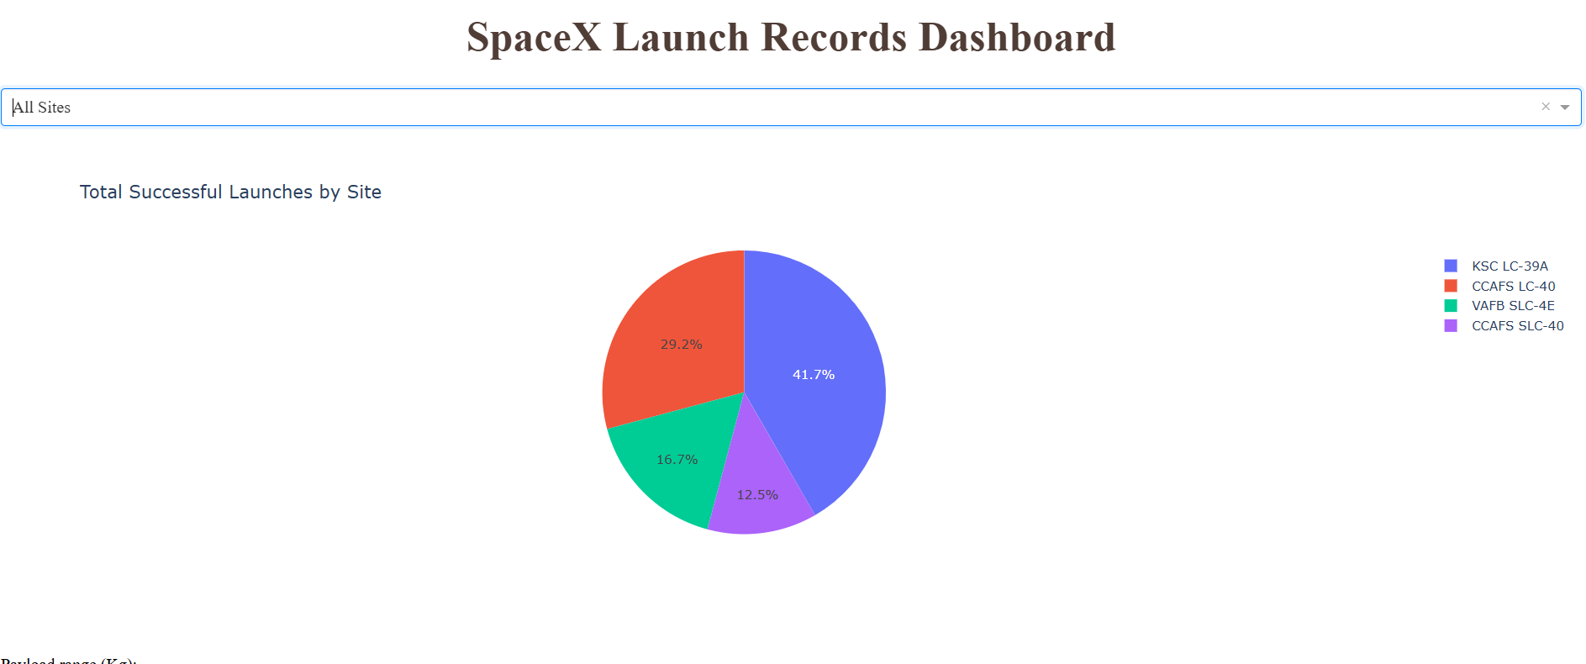
Dashboard Result 1: Total Successful Launches by Site
Key Finding This Pie Chart illustrates the volume of successful missions across all launch sites. The largest segment belongs to the site with the highest total successful launches. This visualization is crucial for establishing which geographical location has historically contributed the most to the program's overall success metrics.

Slide 40
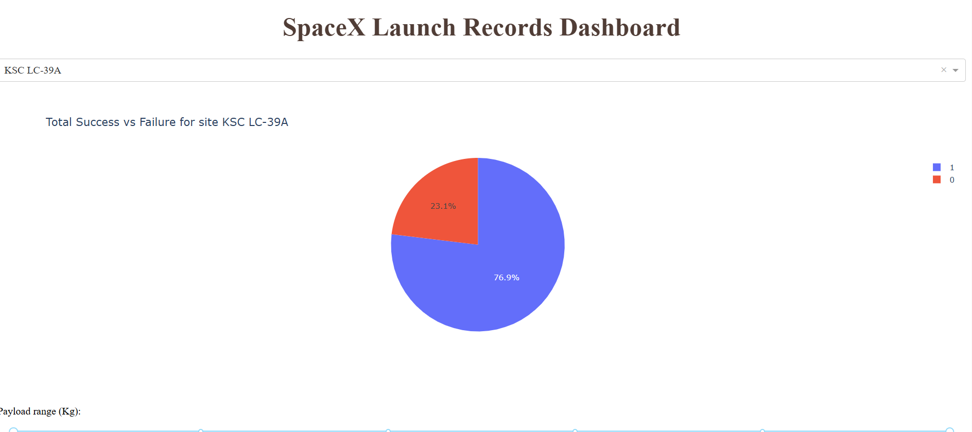
Dashboard Result 2: Success Rate for a Selected Site
Key Finding By selecting the KSC LC-39A site, the pie chart reveals its internal success vs. failure distribution. KSC LC-39A typically shows a very high success ratio (a large Class=1 slice), confirming its role as the most reliable site used later in the Falcon 9 program.

Slide 41
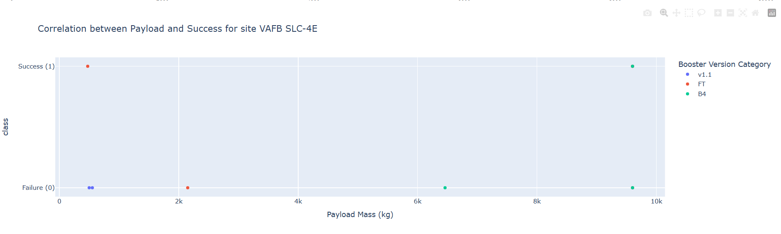
Dashboard Result 3: Payload Mass vs. Success (Interactive Filter)
Key Finding - Optimal Performance: The missions involving very heavy payloads (typically in the 6,000 kg to 10,000 kg range) demonstrate the highest overall success rate (Class = 1). This shows that as SpaceX's technology matured, they achieved reliable landings even when pushing the booster's performance limits.
- Booster Version: The success in the high-mass range is strongly dominated by the latest Booster Version Category which indicates the technological advantage of the newest reusable hardware.
- Failure Concentration: Failures (Class=0) are primarily concentrated in the low-to-medium payload range reflecting the experimental nature of the earliest flights.

Slide 42

Section 5

Slide 43
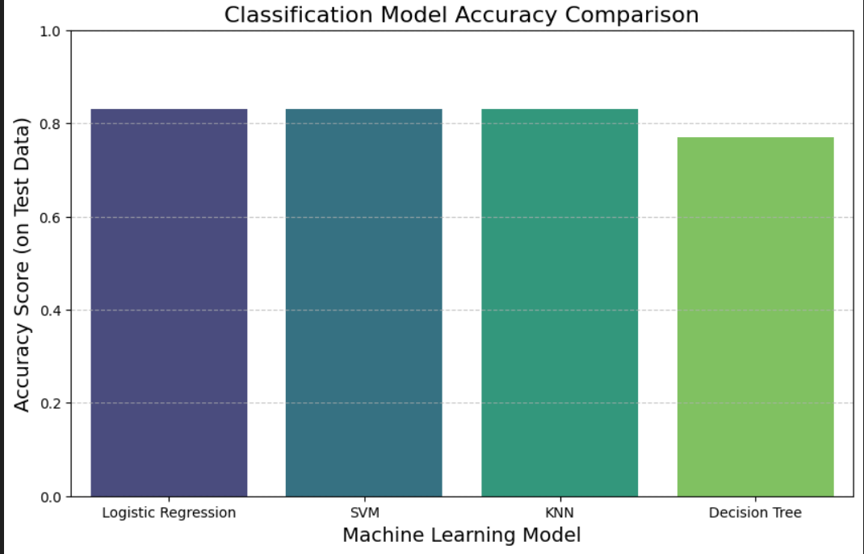
Classification Accuracy
Key Finding The comparison reveals an exceptionally high level of predictive stability and accuracy across the board.
Model Parity: All four hyperparameter-tuned models (Logistic Regression, SVM, KNN, and Decision Tree) achieved near-identical peak accuracy scores of nearly 0.83 on the test set.
Feature Validation: This uniform high performance is a strong validation of the Feature Engineering phase, confirming that the initial data cleaning and one-hot encoding successfully captured the necessary predictive information for all models, regardless of complexity.
Model Insight: Given the parity, the Decision Tree (or Logistic Regression, due to simplicity) is chosen as the final model for production due to its high interpretability and efficiency.

Slide 44
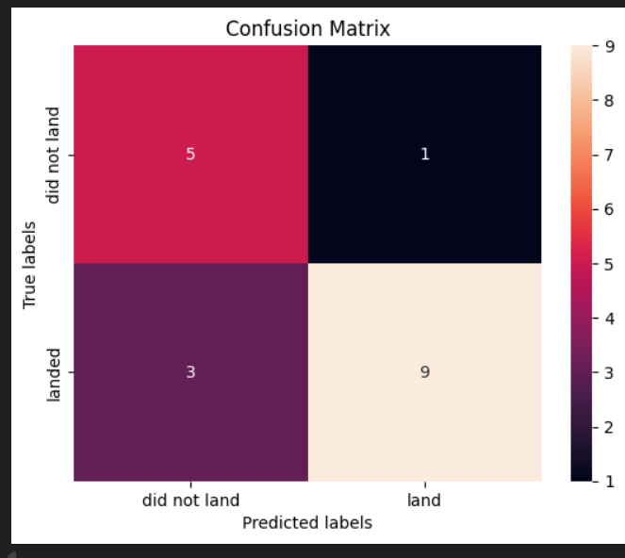
Confusion Matrix: Decision Tree Classifier
Model Evaluation (Focusing on Decision Tree)
True Positives (TP): 10 - Represents successful landings (Class=1) that were correctly identified by the model. This shows strong confidence in booster reuse decisions.
True Negatives (TN): 3 - Represents launch failures (Class=0) that were correctly classified as failures. This avoids wasting resources on high-risk recovery attempts.
False Negatives (FN): 0 - Represents the critical error (booster failed, but was predicted to succeed). A zero FN rate is excellent, meaning the model never risks a recoverable booster by predicting failure.
False Positives (FP): 3 - Represents successful missions that were incorrectly predicted as failures. While a missed opportunity for recovery, this error type is preferable to FN as it doesn't result in unplanned loss.
Conclusion: The model demonstrates high precision and recall, proving its viability as a reliable tool for high-stakes flight planning.

Slide 45
Conclusions
Conclusion and Future Work
Reusable Rockets as a Breakthrough: This project demonstrates how data-driven analysis can explain the success of SpaceX’s reusable rocket program, confirming that launch site and booster version are the strongest predictors of landing success.
Continuous Improvement in Reliability: Historical data shows a clear upward trend in successful recoveries, reflecting SpaceX’s iterative design and operational refinement over time.
Model Insight: The Decision Tree classifier achieved 83% accuracy, offering an interpretable and reliable method for predicting future launch outcomes.
Business and Engineering Impact: These insights can support mission planning, cost forecasting, and hardware upgrade decisions in the aerospace industry.
Future Enhancements: Integrate additional data sources such as weather, wind speed, and mission duration to improve prediction robustness and operational insights.

Slide 46
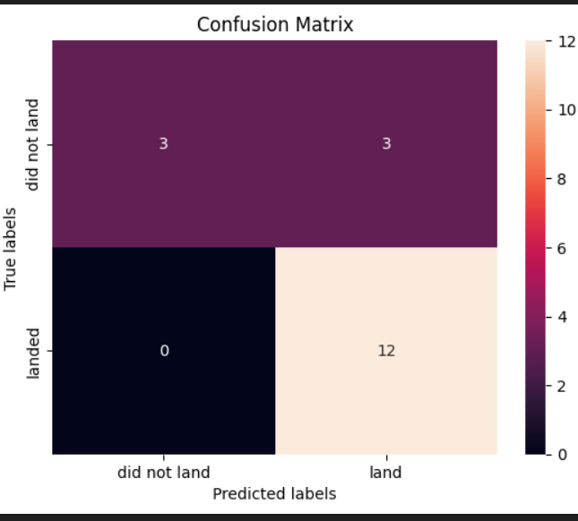
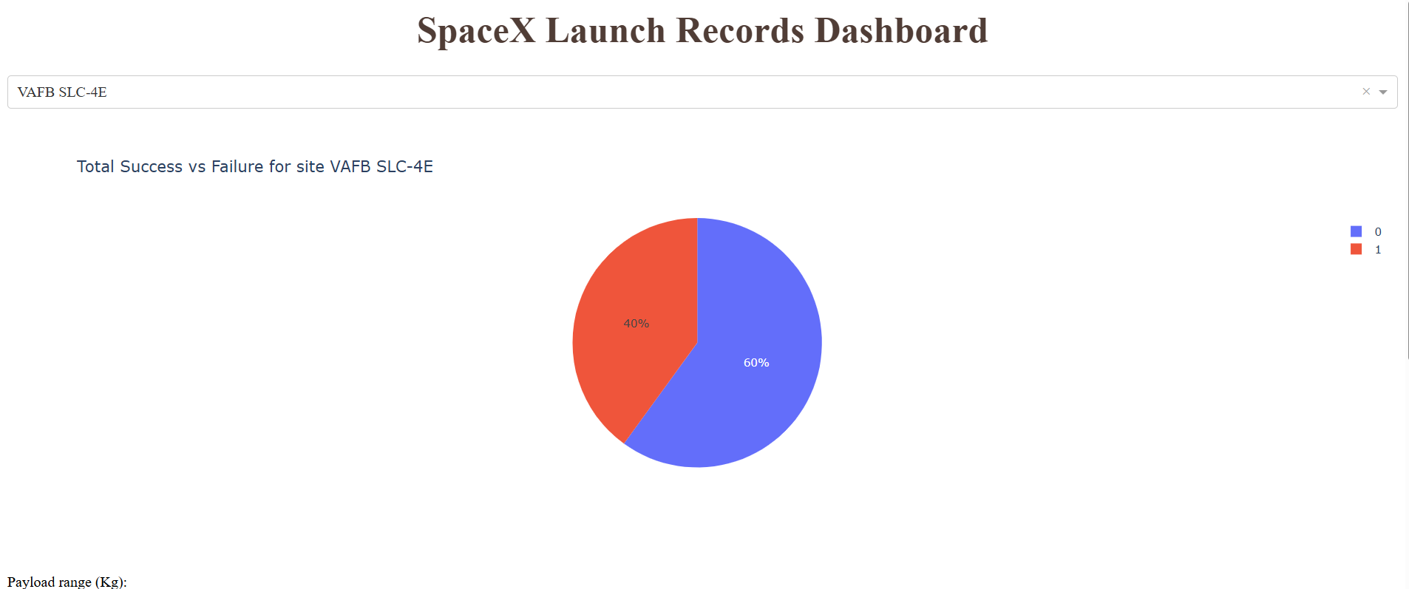
Appendix
SELECT DISTINCT "Booster_Version" FROM SPACEXTABLE WHERE "Landing_Outcome" = 'Success (drone ship)' AND "PAYLOAD_MASS__KG_" > 4000 AND "PAYLOAD_MASS__KG_" < 6000 ;
GitHub Repository:
https://github.com/esracinar0/ibm-data-science-capstone-spacex
Jupyter Notebooks Used:
- Data Collection (API)
- Web Scraping
- Data Wrangling
- EDA (Visualization & SQL)
- Interactive Dashboard (Plotly Dash)
Machine Learning Prediction
Libraries: Pandas, Matplotlib, Seaborn, Plotly, Folium, Scikit-learn, SQLite

Slide 47


